Slide 1

Building and Mining Knowledge graphs
(KEN4256)
Lecture 4: KG Retrieval (SPARQL)

Slide 2
© 2024 by Michel Dumontier and the Institute of Data Science at Maastricht University is licensed under Attribution 4.0 International
To view a copy of this license, visit http://creativecommons.org/licenses/by/4.0/
This license requires that reusers give credit to the creator. It allows reusers to distribute, remix, adapt, and build upon the material in any medium or format, even for commercial purposes.
id: KEN4256_L4
version: 1.2024.0
created: February 2, 2019
last modified: March 26, 2024
published on: March 26, 2024

Slide 3
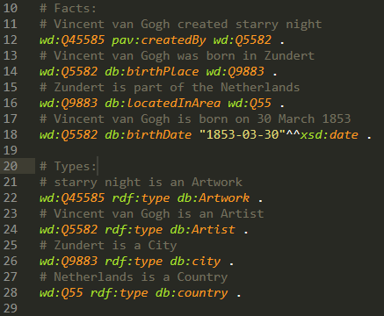

Today
?
Where was Vincent van Gogh born?
I already have a Knowledge Graph, how can I retrieve relevant information from it?

Slide 4
SPARQL W3C specification
SPARQL (pronounced “sparkle”) is a recursive acronym which stands for the SPARQL Protocol And RDF Query Language.
SPARQL 1.0 W3C-Recommendation since January 15th 2008, SPARQL 1.1 W3C-Recommendation since March 21st 2013
SPARQL 1.1 consists of a set of specifications:
Query language for RDF (how to retrieve information from RDF graphs)* Focus of today’s session
Federated queries (extension of query language with features for executing queries over multiple distributed RDF graphs on the Web)
Graph updates (features for how to manipulate RDF graphs e.g. inserting or deleting triples)
Supported entailment regimes (“flavours of reasoning” possible with SPARQL implementations)
Query results formatting JSON, XML, CSV etc. (how to represent query results in various data formats)
Protocol (how to communicate SPARQL queries with services/implementations that process them)
Service Description (How to discover SPARQL services and a vocab for describing them)
Graph Store HTTP Protocol (An alternative to graph updates spec - use HTTP to manipulate graphs)
Test Cases - A suite of tests, helpful for understanding corner cases in the specification and assessing whether a system is SPARQL 1.1 conformant
Relevant to us for writing & executing queries
Relevant to developers of RDF graph management systems and SPARQL engines

Slide 5
Specifications vs. technologies / implementations
W3C specifications for SPARQL (and RDF, RDFS) are essentially blueprints for how to build technologies (i.e. what constraints / requirements should these technologies satisfy)
Caution: in the “Wild Wild Web”, there are many implementations claiming to comply with W3C standards. Some don’t, some do, some are more reliable than others. We will try to expose you in this course to the more established and reputable ones. If there is any doubt about W3C conformance for specific implementations, the W3C specs are the “go to” ground truth resources and there are test specs.

Slide 6
Working with large RDF graphs
Just like the relational database (RDB) world has a host of Database Management Systems (DBMSs) e.g. MySQL, PostgreSQL, there is analogous infrastructure for RDF graphs
Software for managing RDF graphs are often called (Semantic / RDF) graph database systems or triplestore / quadstore implementations. When you load / manage your RDF from these systems it is called a triplestore / quadstore
These systems usually contain software for interpreting and executing SPARQL queries (called a SPARQL engine) and allow one to access / query triplestores by exposing a URL (called a SPARQL endpoint) which you can pose queries to using the SPARQL protocols (much like Web APIs in the RDB world).
Alternatively, many of these systems also have web user interfaces where you can type out and execute SPARQL queries on the triplestore

Slide 7




Managing real-world RDF graphs: RDB vs. RDF
Relational DBs
RDF triplestores
Concept: relational database model (table relations, attributes, primary key, foreign key)
Concept: RDF abstract model for capturing information as triples (subject, predicate, object)
Query language: Structured Query Language (SQL)
Query language: SPARQL
RDBMS implementations: MySQL,
PostgresQL...
Triplestore implementations:
Virtuoso, Allegrograph, GraphDB...
Access to relational DBs: (Web) APIs provide access to DB through URL endpoints that can be queried from code or web user interfaces
Access to RDF graphs: SPARQL endpoint URL provides access to triplestore which can be queried from code or web user interfaces

Slide 8
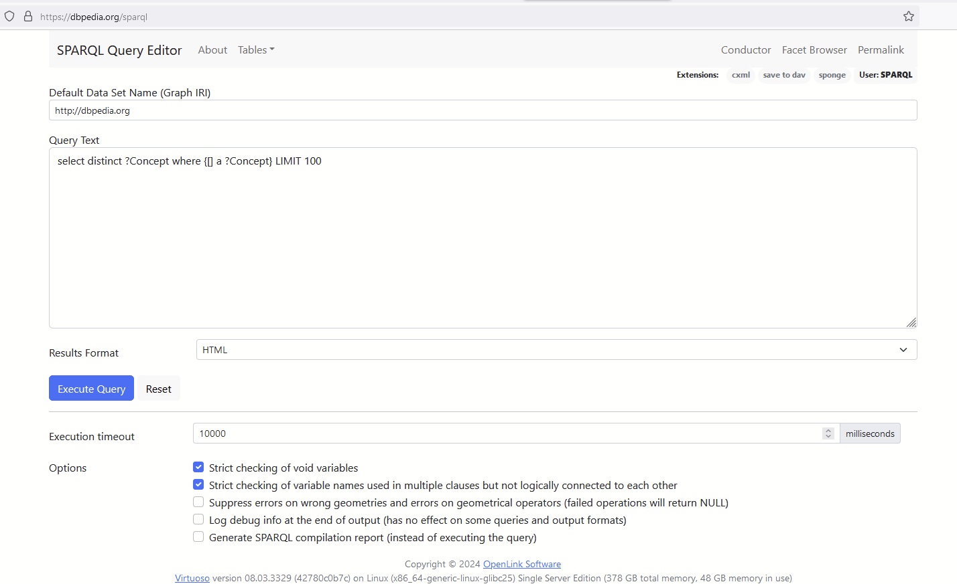
Accessing SPARQL Endpoints
Many SPARQL endpoints provide a user interface to submit a query and view the results
SPARQL endpoint are accessible via parameterised HTTP(S) URLs using HTTP GET and/or HTTP POST operation.

Slide 9
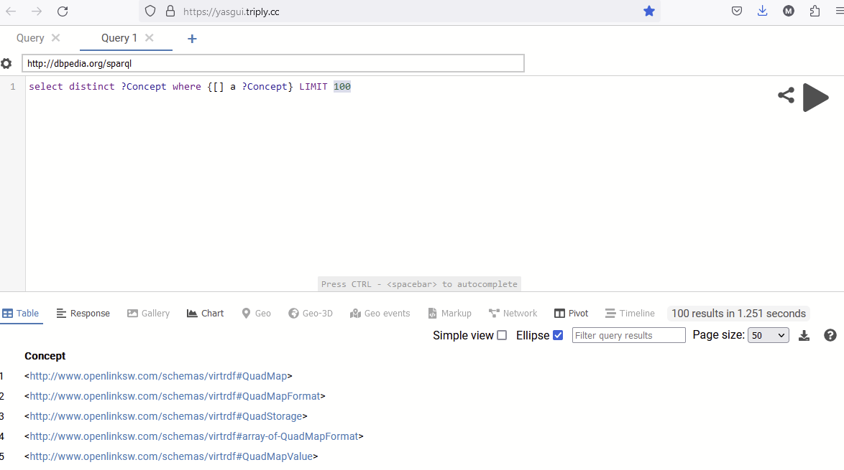
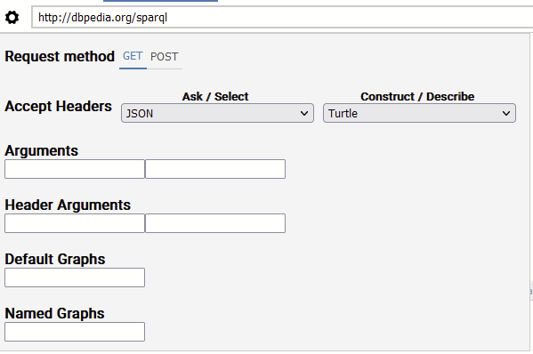
YASGUI is a nice client side SPARQL query UI tool
some SPARQL endpoints accept either GET or POST, but not both
https://yasgui.triply.cc

Slide 10
Types of SPARQL queries
Four types of operations:
SELECT: Retrieve entities matching identified variables from graph pattern
CONSTRUCT: create a target graph from graph pattern
UPDATE (INSERT/DELETE): Add / remove triples in an RDF graph
ASK: Returns a boolean answer (true/false) to specified graph pattern

Slide 11
SPARQL graph patterns
dbo:Book
dbr:Unended_Quest
Match
dbr:Zadig
?x
rdf:type
rdf:type
?x
Main idea is to identify parts of a data graph that matches a defined graph pattern.
dbr:Lucian
dbr:Voltaire
dbo:author
dbr:Karl_Popper
dbo:author
the WHERE { .. } clause defines a basic graph pattern
dbo:influenced
dbr:John_Locke
dbo:influenced
WHERE {
?x rdf:type dbo:Book .
}
dbr:Roger_Penrose
triple pattern
dbo:influenced
constants are fixed IRIs or literals
variables are defined by a question mark "?". They can take on any literal name (e.g. ?x, ?book, ?Book).
here, the graph pattern must match any node in the graph which is the subject for in the triple pattern (?x, rdf:type, dbo:Book).

Slide 12
Anatomy of a SPARQL query
PREFIX dbo:<http://dbpedia.org/ontology/> PREFIX rdfs:<http://www.w3.org/2000/01/rdf-schema#> SELECT ?name ?author ?pages WHERE { ?book a dbo:Book ; dbo:author ?author ; dbo:numberOfPages ?pages ; rdfs:label ?name . FILTER (?pages > 500) FILTER (langMATCHES(LANG(?name),"en")) } ORDER BY ?pages LIMIT 10
Prefix declarations
Variables to display in the results
“Triple patterns” to match in the graph
Where clause to define the basic graph pattern (BGP)
Match and filter specific triples
Filter triples based on the values of some entities
Solution sequence modifiers:
Order by, group by, offset, limit clauses

Slide 13
Anatomy of a SPARQL query (cont...)
PREFIX dbo:<http://dbpedia.org/ontology/> PREFIX rdfs:<http://www.w3.org/2000/01/rdf-schema#> SELECT * FROM <...> WHERE { ?book a dbo:Book ; dbo:author ?author ; dbo:numberOfPages ?pages ; rdfs:label ?name . FILTER (?pages > 500) FILTER (langMATCHES(LANG(?name),"en")) } ORDER BY ?pages LIMIT 10
Type of query: SELECT, CONSTRUCT, INSERT ...
FROM: URI for specific subgraph you want to query
*
Return all variables in the BGP

Slide 14
SPARQL Triple pattern
PREFIX dbo:<http://dbpedia.org/ontology/> PREFIX rdfs:<http://www.w3.org/2000/01/rdf-schema#> PREFIX dbr: <http://dbpedia.org/resource/> SELECT * WHERE { dbr:Havana_Storm a dbo:Book . }
0 variables
Returns the number of occurrences of this triple in the graph

Slide 15
SPARQL Triple pattern
PREFIX dbo:<http://dbpedia.org/ontology/> PREFIX rdfs:<http://www.w3.org/2000/01/rdf-schema#> PREFIX dbr: <http://dbpedia.org/resource/> SELECT * WHERE { ?s ?p ?o . }
Match any triple.
Return the position-bound variables (e.g. ?s ?p ?o)

Slide 16
SPARQL Triple pattern
PREFIX dbo:<http://dbpedia.org/ontology/> PREFIX rdfs:<http://www.w3.org/2000/01/rdf-schema#> PREFIX dbr: <http://dbpedia.org/resource/> SELECT * WHERE { ?s ?p dbo:Book . } SELECT * WHERE { ?s rdf:type ?o . }
SELECT * WHERE { dbr:Havana_Storm ?p ?o . }
OR
OR
Match all triples
that contain the position-bound constant.
Return the remaining 2 solution bound variables

Slide 17
SPARQL Triple pattern
PREFIX dbo:<http://dbpedia.org/ontology/> PREFIX rdfs:<http://www.w3.org/2000/01/rdf-schema#> PREFIX dbr: <http://dbpedia.org/resource/> SELECT * WHERE { ?s rdf:type dbo:Book . } SELECT * WHERE { dbr:Havana_Storm ?p dbo:Book . }
SELECT * WHERE { dbr:Havana_Storm rdf:type ?o . }
OR
OR
Match all triples
that contains two position-bound constants.
Return the solution bound variable.

Slide 18
Poll point 2: Querying an RDF graph
dbo:Book
dbr:Unended_Quest
Which books have authors which influenced the philosopher John Locke?
dbr:Zadig
rdf:type
rdf:type
dbr:Lucian
dbr:Voltaire
dbo:author
dbr:Karl_Popper
dbo:author
dbr:Zadig rdf:type dbo:Book .
dbr:Unended_Quest rdf:type dbo:Book .
dbr:Zadig dbo:author dbr:Voltaire .
dbr:Unended_Quest dbo:author dbr:Karl_Popper .
dbr:Karl_Popper dbo:influenced dbr:Roger_Penrose .
dbr:Voltaire dbo:influenced dbr:Lucian .
dbr:Voltaire dbo:influenced dbr:John_Locke
dbo:influenced
dbr:John_Locke
dbo:influenced
dbr:Roger_Penrose
dbo:influenced
How did you arrive at the answer? What “patterns” did you notice?

Slide 19
SPARQL graph patterns
No Match
dbo:Book
dbr:Unended_Quest
Match
dbr:Zadig
?x1
rdf:type
rdf:type
?x1
PREFIX dbo:<http://dbpedia.org/ontology/> PREFIX rdfs:<http://www.w3.org/2000/01/rdf-schema#> PREFIX dbr:<http://dbpedia.org/resource/> SELECT ?x1 WHERE { ?x1 rdf:type dbo:Book . ?x1 dbo:author ?x2 . ?x2 dbo:influenced dbr:John_Locke . }
dbr:Lucian
dbo:author
dbr:Voltaire
?x2
dbr:Karl_Popper
dbo:author
dbo:influenced
(Basic) graph pattern: chain triple patterns together
dbr:John_Locke
?x2
dbo:influenced
dbr:Roger_Penrose
dbo:influenced
Logical reading: I am looking for some entity in the graph, let’s call it “x1”. It should have an rdf:type relation to the entity “dbo:Book”. It should also have a “dbo:author” relation to some other entity, let’s call it “x2”. Finally, “x2” should have a “dbo:influenced” relation to the entity “dbr:John_Locke”. x1 and x2 can have other relations as well, but the ones mentioned above are mandatory to match the pattern.
Intuitive reading: select all books from DBpedia where the author of this book influenced John Locke.

Slide 20
Example SPARQL query
Query
Graph
PREFIX : <http://somenamespace.org/>
PREFIX schema: <http://schema.org/>
SELECT ?s
WHERE {
?s :hasChild ?c .
?c schema:gender schema:Male .
}
:catherine :hasChild :jessica .
:jessica schema:gender schema:Female .
:linda :hasChild :jason .
:jason schema:gender schema:Male .
s
:linda
:linda is a valid “binding” for ?s in this query
“All people who have male children”

Slide 21
Example SPARQL query (*)
Query
Graph
PREFIX : <http://somenamespace.org/>
PREFIX schema: <http://schema.org/>
SELECT *
WHERE {
?s :hasChild ?c .
?c schema:gender schema:Male .
}
:catherine :hasChild :jessica .
:jessica schema:gender schema:Female .
:linda :hasChild :jason .
:jason schema:gender schema:Male .
s | c
:linda | :jason
Use of * means to find bindings for EACH variable in the BGP. In simple terms: “find all possible values for ?s and ?c that satisfy this graph pattern”

Slide 22
Example SPARQL query
Query
Graph
PREFIX : <http://somenamespace.org/>
PREFIX schema: <http://schema.org/>
SELECT ?s
WHERE {
?s :hasChild ?c .
?c schema:gender schema:Male .
}
:catherine :hasChild :jessica .
:jessica schema:gender schema:Female .
:john :hasChild :sophie .
:sophie schema:gender schema:Female .
:sophie schema:sibling :george .
:george schema:gender schema:Male .
:linda :hasChild :jason .
:jason schema:gender schema:Male .
“All people who have male children”

Slide 23
SPARQL reasoning
Query
Graph
PREFIX : <http://somenamespace.org/>
PREFIX schema: <http://schema.org/>
SELECT ?s
WHERE {
?s :hasChild ?c .
?c schema:gender schema:Male .
}
:catherine :hasChild :jessica .
:jessica schema:gender schema:Female .
:john :hasChild :sophie .
:john :hasSon :george .
:sophie schema:gender schema:Female .
:sophie schema:sibling :george .
:george schema:gender schema:Male .
:linda :hasChild :jason .
:jason schema:gender schema:Male .
:hasSon rdfs:subPropertyOf :hasChild .
SPARQL 1.1 entailments
“All people who have male children ”

Slide 24
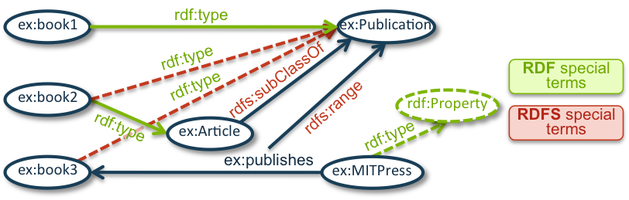
SPARQL Entailments
(1) ex:book1 rdf:type ex:Publication .
(2) ex:book2 rdf:type ex:Article .
(3) ex:Article rdfs:subClassOf ex:Publication .
(4) ex:publishes rdfs:range ex:Publication .
(5) ex:MITPress ex:publishes ex:book3 .
simple entailment only exact matches.
RDF entailment follows the RDF rules:
if: uuu aaa yyy . (rdf1)
then: aaa rdf:type rdf:Property .
-> ex:publishes rdf:type rdf:Property
RDFS entailment follows the RDF + RDFS rules.
if: uuu rdfs:subClassOf xxx . (rdfs9)
then: vvv rdf:type uuu .
vvv rdf:type xxx .

Slide 25
DISTINCT & COUNT
Query
Graph
PREFIX : <http://somenamespace.org/>
PREFIX schema: <http://schema.org/>
SELECT ?s
WHERE {
?s :hasChild ?c .
?c schema:gender schema:Male .
}
:catherine :hasChild :jessica .
:jessica schema:gender schema:Female .
:linda :hasChild :jason .
:jason schema:gender schema:Male .
:linda :hasChild :luke .
:luke schema:gender schema:Male .
s | c
:linda | :jason
:linda | :luke
“All people who have male children”
Two possible bindings for ?s and ?c
1.
2.

Slide 26
DISTINCT & COUNT
Query
Graph
PREFIX : <http://somenamespace.org/>
PREFIX schema: <http://schema.org/>
SELECT ?s
WHERE {
?s :hasChild ?c .
?c schema:gender schema:Male .
}
:catherine :hasChild :jessica .
:jessica schema:gender schema:Female .
:linda :hasChild :jason .
:jason schema:gender schema:Male .
:linda :hasChild :luke .
:luke schema:gender schema:Male .
s
:linda
:linda
“All people who have male children”
Two possible bindings for ?s and ?c
1.
2.

Slide 27
DISTINCT & COUNT
Query
Graph
PREFIX : <http://somenamespace.org/>
PREFIX schema: <http://schema.org/>
SELECT DISTINCT ?s
WHERE {
?s :hasChild ?c .
?c schema:gender schema:Male .
}
:catherine :hasChild :jessica .
:jessica schema:gender schema:Female .
:linda :hasChild :jason .
:jason schema:gender schema:Male .
:linda :hasChild :luke .
:luke schema:gender schema:Male .
s
:linda
“Unique people who have male children”
DISTINCT filters out the duplicates
Multiple variables with DISTINCT?

Slide 28
DISTINCT & COUNT
Query
Graph
PREFIX : <http://somenamespace.org/>
PREFIX schema: <http://schema.org/>
SELECT COUNT(?s)
WHERE {
?s :hasChild ?c .
?c schema:gender schema:Male .
}
:catherine :hasChild :jessica .
:jessica schema:gender schema:Female .
:linda :hasChild :jason .
:jason schema:gender schema:Male .
:linda :hasChild :luke .
:luke schema:gender schema:Male .
result
2
“How many people have male children”
Two possible bindings for ?s and ?c

Slide 29
DISTINCT & COUNT
Query
Graph
PREFIX : <http://somenamespace.org/>
PREFIX schema: <http://schema.org/>
SELECT COUNT(DISTINCT(?s))
WHERE {
?s :hasChild ?c .
?c schema:gender schema:Male .
}
:catherine :hasChild :jessica .
:jessica schema:gender schema:Female .
:linda :hasChild :jason .
:jason schema:gender schema:Male .
:linda :hasChild :luke .
:luke schema:gender schema:Male .
“How many unique people have male children”
result
1

Slide 30
LIMIT & ORDER BY
Query
Graph
PREFIX : <http://somenamespace.org/>
PREFIX schema: <http://schema.org/>
SELECT ?s
WHERE {
?s :hasChild ?c .
?c schema:gender schema:Male .
}
LIMIT 1
:catherine :hasChild :jessica .
:jessica schema:gender schema:Female .
:linda :hasChild :jason .
:jason schema:gender schema:Male .
:kevin :hasChild :scott .
:scott schema:gender schema:Male .
s
:linda
s
:kevin
OR
“Only give 1 result for people who have male children”

Slide 31
LIMIT & ORDER BY
Query
Graph
PREFIX : <http://somenamespace.org/>
PREFIX schema: <http://schema.org/>
SELECT ?s
WHERE {
?s :hasChild ?c .
?s schema:birthDate ?dob .
?c schema:gender schema:Male .
}
ORDER BY DESC (?dob)
:linda :hasChild :jason .
:jason schema:gender schema:Male .
:kevin :hasChild :scott .
:scott schema:gender schema:Male .
:kevin schema:birthDate “1977-05-05”^^xsd:date .
:linda schema:birthDate “1988-06-03”^^xsd:date .
s
:linda
:kevin
Most recent to oldest
“People who have male children, order by date of birth youngest to oldest.”

Slide 32
LIMIT & ORDER BY
Query
Graph
PREFIX : <http://somenamespace.org/>
PREFIX schema: <http://schema.org/>
SELECT ?s
WHERE {
?s :hasChild ?c .
?s schema:birthDate ?dob .
?c schema:gender schema:Male .
}
ORDER BY ASC(?dob)
:linda :hasChild :jason .
:jason schema:gender schema:Male .
:kevin :hasChild :scott .
:scott schema:gender schema:Male .
:kevin schema:birthDate “1977-05-05”^^xsd:date .
:linda schema:birthDate “1988-06-03”^^xsd:date .
s
:kevin
:linda
“People who have male children, order by date of birth oldest to youngest”

Slide 33
FILTER (numeric)
Query
Graph
PREFIX : <http://somenamespace.org/>
PREFIX schema: <http://schema.org/>
SELECT ?s
WHERE {
?s :hasChild ?c .
?c schema:gender schema:Male .
?c :height ?heightc .
FILTER (?heightc > 175 && ?heightc < 190)
}
:linda :hasChild :jason .
:jason schema:gender schema:Male .
:kevin :hasChild :scott .
:scott schema:gender schema:Male .
:kevin :height “174”^^xsd:integer .
:linda :height “160”^^xsd:integer .
:scott :height “178”xsd:integer .
:jason :height “192”^^xsd:integer .
s
:kevin
“People who have male children in a certain height range”

Slide 34
FILTER (numeric & casting)
Query
Graph
PREFIX : <http://somenamespace.org/>
PREFIX schema: <http://schema.org/>
SELECT ?s
WHERE {
?s :hasChild ?c .
?c schema:gender schema:Male .
?c :height ?heightc .
FILTER (xsd:integer(?heightc) > 175 && xsd:integer(?heightc) < 190)
}
:linda :hasChild :jason .
:jason schema:gender schema:Male .
:kevin :hasChild :scott .
:scott schema:gender schema:Male .
:kevin :height “174” .
:linda :height “160” .
:scott :height “178” .
:jason :height “192” .
s
:kevin
“People who have male children in a certain height range”

Slide 35
FILTER (string)
Query
Graph
PREFIX : <http://somenamespace.org/>
PREFIX schema: <http://schema.org/>
SELECT ?c
WHERE {
?s :hasChild ?c .
?c schema:gender schema:Male .
?c :lastname ?lastnamec .
FILTER (?lastnamec = “Wilson”)
}
:linda :hasChild :jason .
:jason schema:gender schema:Male .
:kevin :hasChild :scott .
:scott schema:gender schema:Male .
:linda :lastname “Wilson” .
:jason :lastname “Wilson” .
:kevin :lastname “Smith” .
:scott :lastname “Smith” .
s
:jason
“male children with the last name Wilson”

Slide 36
Additional operations & functions
Math operations, datatype & casting
Will this work: write a query to find all people older than 25? No
Math: Average number of pages in a book
No data type specified!
This is just a string
...
<http://.../peter> <http://.../age> “36” .
...
SELECT AVG(?pages)
WHERE{
?book a dbo:Book .
?book dbo:author ?author .
?author dbo:numberOfPages ?pages .
}
Result
"322.647058823529412"^^<http://www.w3.org/2001/XMLSchema#decimal>
datatype:
Casting:
SELECT datatype(?age)
WHERE{
…
}
Results
xsd:string
SELECT ?person
WHERE{
...
FILTER(xsd:integer(?age) > 25) .
}
Results
peter

Slide 37
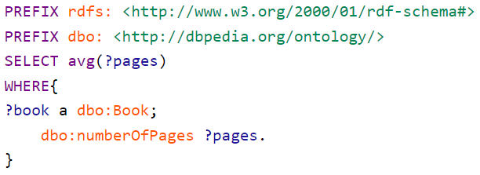
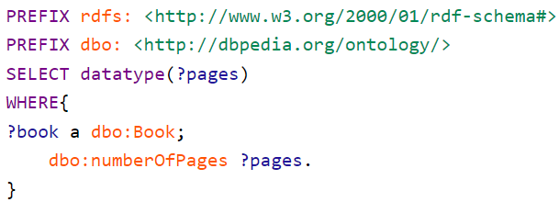
Additional SPARQL functions
Math operations: AVG(), SUM(),MAX(), MIN()
datatype & casting
- Average number of pages
- datatype of variable ?pages:

Slide 38
Additional operations & functions
BIND, concat, uri
uri:
uri(“http://.../entity”) .
<“http://.../entity”>
BIND:
SELECT ?person ?bmi
WHERE{
?person a schema:Person .
?person schema:height ?height .
?person schema:weight ?weight .
BIND((?weight / (?height * ?height)) AS ?bmi) .
}
Result
Peter, 25.5
Sally, 24,3
Ken, 34.7
concat:
SELECT ?fullname
WHERE{
?peter :firstname ?firstname .
?peter :lastname ?lastname .
BIND (concat(?firstname,?lastname) AS ?fullname) .
}
Results
Peter Smith

Slide 39
SPARQL string functions
More about other string functions (such as LCASE, STRAFTER, SUBSTR)
https://www.w3.org/TR/sparql11-query/#func-strings

Slide 40
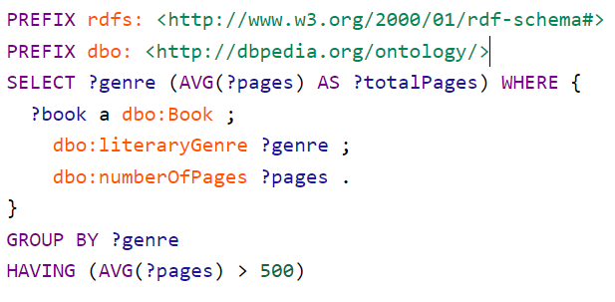
Additional SPARQL functions
GROUP BY: divides results into groups and does any necessary calculations for each group
HAVING: very similar to FILTER but works on aggregated results (groups), rather than individual solutions
Notes:
difference between FILTER and HAVING in SPARQL?

Slide 41
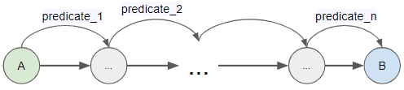
Additional triple pattern features
Property paths: A property path is a possible route through a graph between two graph nodes
r | ... | s AlternativePath: Match one or both possibilities
r / … / s SequencePath: Find an A->r->s->B chain
r + … + s OneOrMorePath:
{ :book1 dc:title|rdfs:label ?bookname }
{ ?x a foaf:Person .
?x foaf:knows/foaf:knows/foaf:name ?name . }
{
?x foaf:mbox <mailto:alice@example> .
?x foaf:knows+/foaf:name ?name .
}
Notes:
Find the name of any people that Alice knows.
Find the names of people 2 "foaf:knows" links away.
Find the names of all the people that can be reached from Alice by foaf:knows:

Slide 42
Additional triple pattern features
OPTIONAL: We can define optional patterns that will be retrieved when available.
Data
Query
:alice rdf:type foaf:Person .
:alice foaf:name "Alice" .
:alice foaf:mbox <mailto:alice@example.com> .
:alice foaf:mbox <mailto:alice@work.example> .
:bob rdf:type foaf:Person .
:bob foaf:name "Bob" .
PREFIX foaf: <http://xmlns.com/foaf/0.1/>
SELECT ?name ?mbox WHERE {
?x foaf:name ?name .
OPTIONAL { ?x foaf:mbox ?mbox }
}
Result
What would the result be without the OPTIONAL keyword?
name | mbox
"Alice" | <mailto:alice@example.com>
"Alice" | <mailto:alice@work.example>
"Bob"
name | mbox
"Alice" | <mailto:alice@example.com>
"Alice" | <mailto:alice@work.example>
Notes:
All of patterns are in conjunctive form, for example if a person does not have email data it will not appear in the results. We can use a keyword “optional”

Slide 43
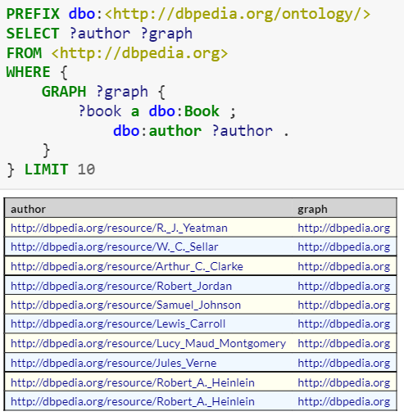
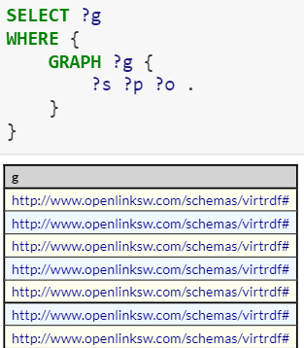
We can query the triples FROM a specific graph:
List all (named) subgraphs in particular endpoint
Notes:
In specific subgraph of current endpoint
All graph on same endpoint.

Slide 44
Subqueries
SELECT # which variables to return WHERE { { # start of the subquery SELECT # which variables to return WHERE { # query pattern } # query modifiers } # end of the subquery # query pattern } # query modifiers
Querying the KG to select a subgraph as part of the solution and serve that subgraph to outer query
Final process for the subgraph that comes from inner query

Slide 45
Subqueries
No Match
dbo:Book
dbr:Unended_Quest
Match
dbr:Zadig
?x1
rdf:type
rdf:type
?x1
PREFIX dbo:<http://dbpedia.org/ontology/> PREFIX dbr:<http://dbpedia.org/resource/> SELECT ?x1 AVG(?pages) WHERE { { SELECT DISTINCT ?x1 WHERE { ?x1 a dbo:Book . ?x1 dbo:author ?x2 . ?x2 dbo:influenced dbr:John_Locke . } } ?x1 dbo:numberOfPages ?pages . ?x1 dbo:author ?author . }
dbr:Lucian
dbr:Voltaire
dbo:author
?x2
dbr:Karl_Popper
dbo:author
dbo:influenced
dbr:John_Locke
?x2
Pattern matching within this subgraph
dbo:influenced
dbr:Roger_Penrose
dbo:influenced
Intuitive reading: the average number of pages in books from DBpedia where the authors of the books influenced John Locke.

Slide 46
Example - Subqueries
“A query inside a query”
Order the first 10 countries that have been dissolved by date of creation.
Select all countries that have been dissolved
Order them by dissolution date (oldest to newest)
Limit to 10
Finally, order the results (10 countries) from the most recently created to the oldest created
The subquery - 10 countries from oldest to newest by their dissolution dates
Notes:
Do it on an aggregate: it is where it is more interesting to optimize the query (do first the limit, then the order by)

Slide 47
Solution
SELECT * WHERE { { SELECT ?country ?dissolutionDate WHERE { ?country a dbo:Country . ?country dbo:dissolutionDate ?dissolutionDate . } order by ?dissolutionDate limit 10 } ?country dbo:foundingYear ?foundingYear . } order by desc(?foundingYear)
Subgraph - 10 ordered countries by their dissolution dates
Sorted subgraph from the most recently created to the oldest created

Slide 48
What does this query do?
SELECT * WHERE { { SELECT ?country ?foundingYear WHERE { ?country a dbo:Country . ?country dbo:foundingYear ?foundingYear . } order by ?foundingYear limit 10 } ?country dbo:dissolutionDate ?dissolutionDate . } order by desc(?dissolutionDate)

Slide 49
Federated queries
dbr:Unended_Quest
dbo:Book
=
dbr:Zadig
dbr:Karl_er
dbr:Roger_Penrose
dbr:Lucian
dbr:Voltaire
dbr:Roger_Penrose
dbr:Roger_Penrose
dbr:John_Locke
Graph 1
Graph 2
There is more info about some entity in another (external) triplestore / SPARQL endpoint. Want to query the full extended graph to get more information about the entity (that is not known by looking at just one of the graphs)

Slide 50
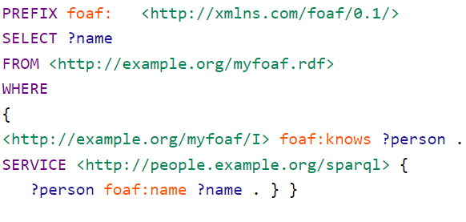
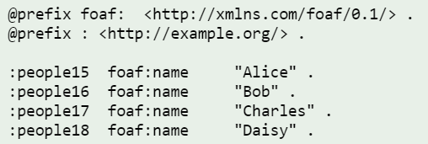
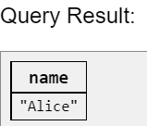
Federated queries
Call to a remote SPARQL endpoint to get the data
Notes:
Combining result from different endpoints
This example shows how to query a remote SPARQL endpoint and join the returned data with the data from the local RDF Dataset. Consider a query to find the names of the people we know. Data about the names of various people is available at the http://people.example.org/sparql endpoint:
and one wants to combine with a local FOAF file http://example.org/myfoaf.rdf that contains the single triple:

Slide 51
Construct, insert and delete
CONSTRUCT: create triples and return them
INSERT: creates triples and inserts the constructed triples into the (specified) graph.
DELETE: similar structure to both CONSTRUCT and INSERT - deletes triples from the graph!

Slide 52
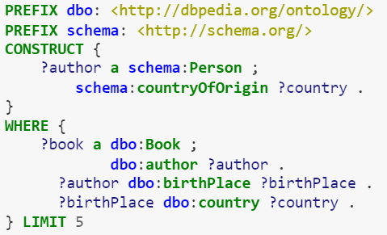
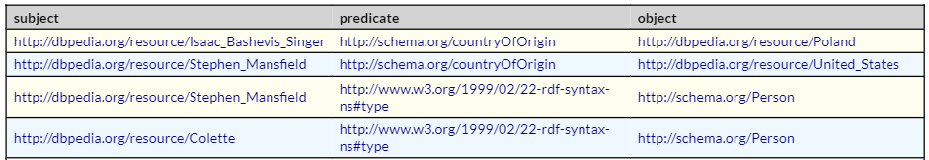
Construct Creates RDF triples from matches
SPARQL query forms
Notes:
A construct query takes data conforming to one model and creates triples conforming to another model. This is great for data integration projects.

Slide 53
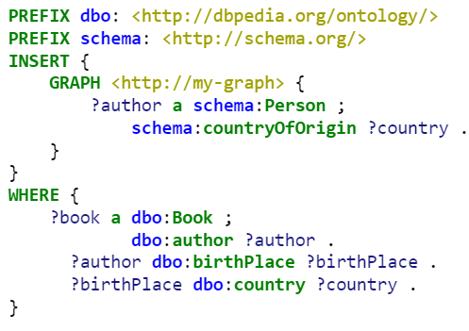
Update: Insert 📝
Same as a construct but directly insert triples into your triplestore. You can define in which graph the triples will be inserted
SPARQL query forms

Slide 54
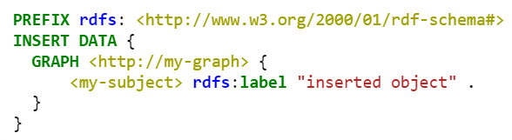
Update: Insert DATA
SPARQL query forms
Simply use SPARQL to insert data into your triplestore.
Inserts a triple pattern with 0 variables into the triplestore
insert this exact triple in the specified graph
Notes:
“Error 500: error. datatype rdf:langString requires a language tag “ on GraphDB (rdf4j).

Slide 55
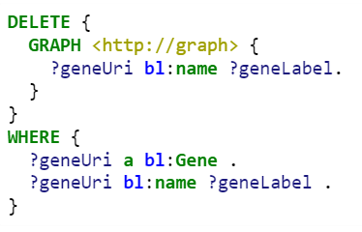
SPARQL query forms
Update: Delete ❌
To delete particular statements retrieved from a pattern using WHERE
Here we delete the bl:name statements for the genes we just created:
Triple pattern to delete
Based on the data retrieved in this where
Notes:
“Error 500: error. datatype rdf:langString requires a language tag “ on GraphDB (rdf4j).

Slide 56
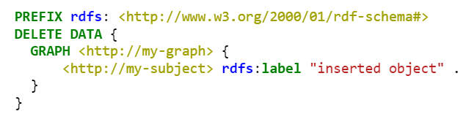
Update: Delete DATA
SPARQL query forms
To delete particular statements. Triple patterns with 0 variables.
Here we delete the rdfs:label statements for the genes we just created
Delete this exact triple
Notes:
“Error 500: error. datatype rdf:langString requires a language tag “ on GraphDB (rdf4j).

